Slide 1
Revolution in Clothing Cleaning
Commercial Washing Machines
New Ultrasonic Cleaning Technology Document
January 2005
Yoshihide Shibano
100 shirts on hangers.
50 suits on hangers.
20 sweaters folded and left in the basket
Wash one at a time, only 5 minutes
This issue covers commercial cleaning.

Slide 2
The Development of Ultrasonic Washing Machines
Sagamihara City, Kanagawa Prefecture
Manufacturer of powerful, ultrasonic, cavitation, and applied technologies
Blue Star R&D, Inc,
Totally new and revolutionary,
We have developed high-speed cleaning technology.
I would like to briefly introduce this new technology.
Manufacture and sale of ultrasonic cleaning equipment, ultrasonic deburring equipment, etc.
Blue Star R&DInc.
Yoshihide Shibano, Technical Advisor
1-31-1 Yokoyamadai, Chuo-ku, Sagamihara-shi, Kanagawa 252-0241
tel 042-711-7721
e-mail shibano@blue-galaxy.co.jp
HP http://www.blue-galaxy.co.jp

Slide 3
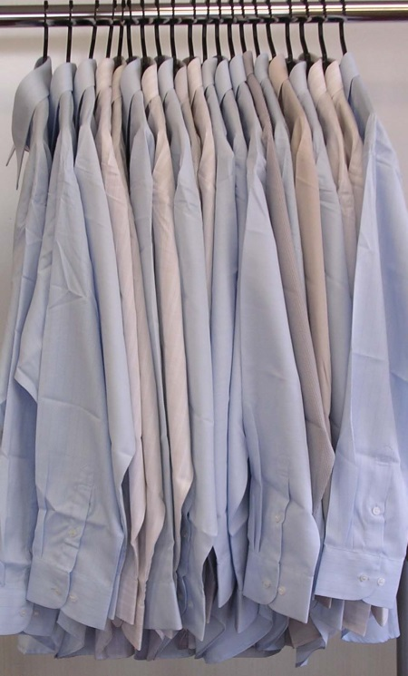
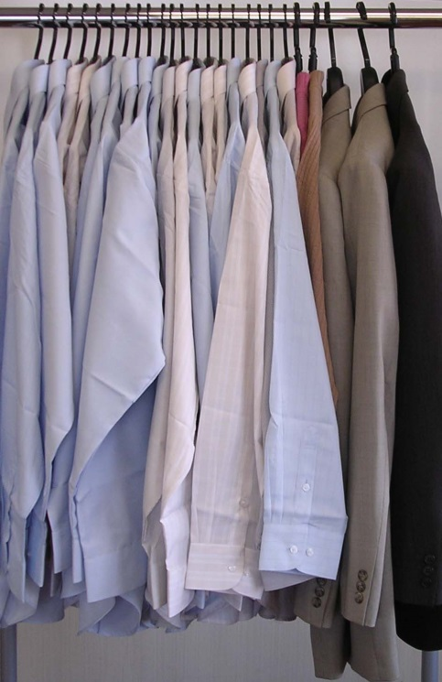
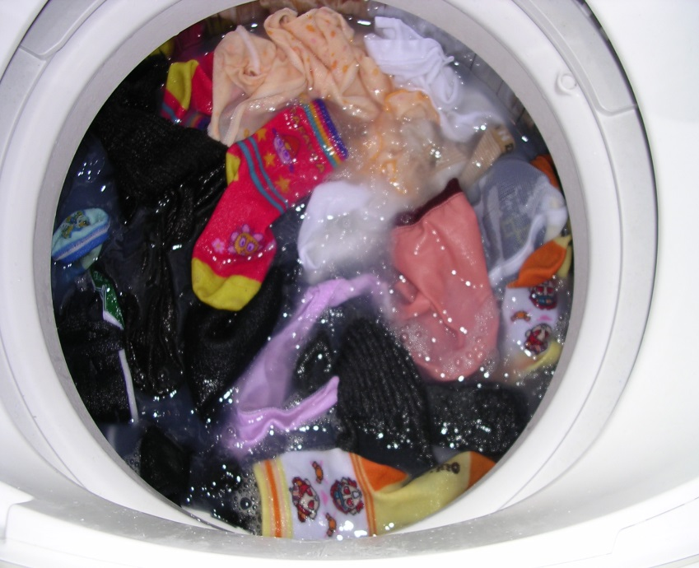
Ultrasonic cleaning of clothes on hangers 100 shirts, 5 minutes, highest cleanliness
New Ultrasonic Cleaning Technology
Conventional Cleaning
Hang it on a hanger and wash it as it is.
Drying and packaging Easy to automate
Jumbled, mixed, entangled
(CLEANING)

Slide 4
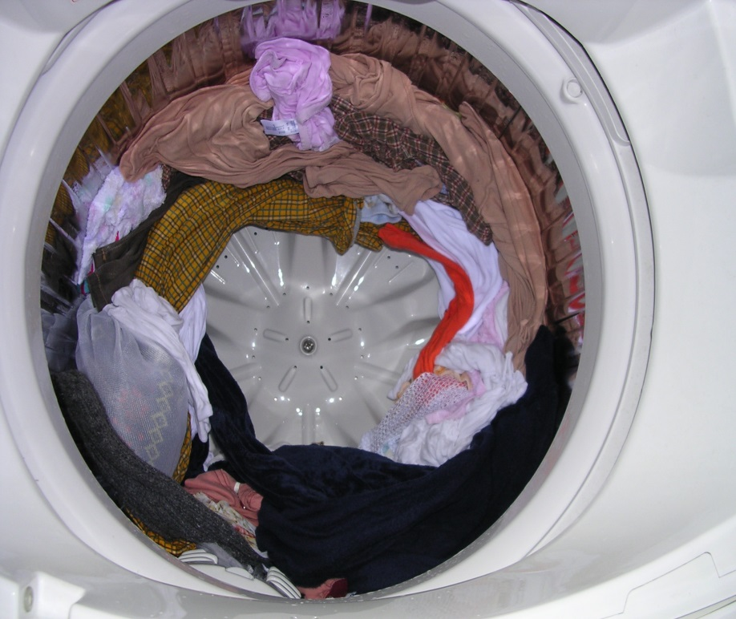
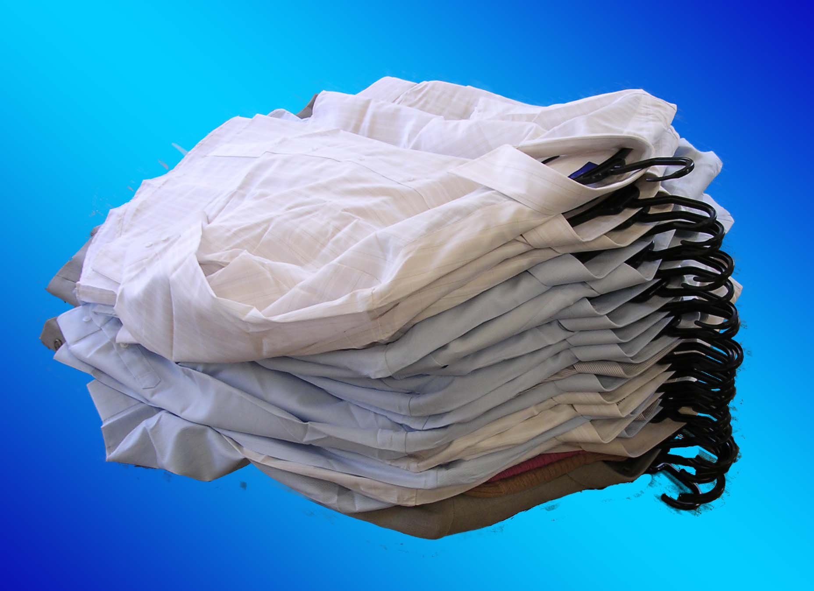
Ultrasonic cleaning of folded clothes 100 shirts, suits, sweaters
New Ultrasonic Cleaning Technology
Conventional Cleaning
Tangle and entanglement
It will not untie!
(After dehydration)
Fold, stack, and clean.
New system ideas are possible.

Slide 5
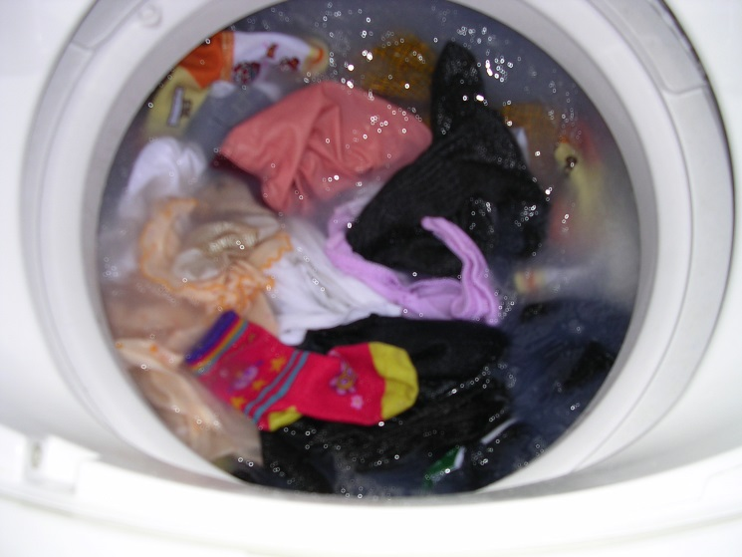
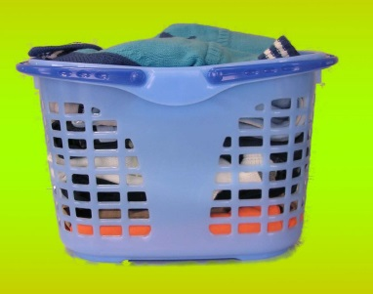
Washable in a basket Separate for each individual/family! Possible
Conventional Cleaning
New Ultrasonic Cleaning Technology
even if it's a family member-by-family
Even by individual
Also by content
No tangling with strangers, no mixing of dirt.
Your exclusive high-speed cleaning.
Tangling with strangers. Did you know?
Your sister and your uncle.
And the naughty boy. And Grandpa.
Clothing in that house and this house,
Everybody's mixed up.
No classification.
I'm talking about the clothing of the

Slide 6
Features of the new ultrasonic cleaning technology (1)
1, Can be cleaned while on a hanger.
Shirts and suits can be cleaned continuously with 20~100 shirts and suits on hangers.
Automation of the cleaning process is facilitated, which reduces costs and ensures high profits.
2. They can be cleaned side by side or stacked on top of each other.
Fabrics that stretch easily, such as suits and sweaters, can be hung on hangers or laid horizontally.
Can be stacked and washed. Of course, 20~100 garments are possible. Gentle cleaning for fabrics.
3, Can be placed in a basket and washed in batches.
It is possible to clean by individual, by family, by type, and by classification. of dirt in each basket.
Prevents mixing. Does not come in contact with unknown dirt. Unknown to you. Unknown to you.
It also helps prevent contact with pathogens.

Slide 7
Features of New Ultrasonic Cleaning Technology (2)
4、Does not damage the fabric. Long-lasting.
This is not a conventional cleaning method based on compressing and expanding fabrics.
The fabric does not move. Only the powerful cavities (microvacuum nuclei group) of ultrasonic waves,
Dirt is removed by high-speed, suction, and supplementation. In other words, fabric pain is almost
No, there is not. (High speed video available). 100 washes painless. For cleaning
There is no entanglement due to the
5、High-speed cleaning・More than double the cleaning power
The cleaning power remains almost the same even after repeated use. General soiling takes only 2 minutes.
Remove dirt, even from the inside of the fabric. Wash, rinse, rinse, and go to dry.
Fully automated systems can be cleaned in 2 to 5 minutes. Even at high speeds, the conventional
More than twice as clean as the cleaning and removal results.

Slide 8
Features of New Ultrasonic Cleaning Technology (3)
6、Cleaning agent is halved. The cleaning power of water alone is doubled.
Compared to conventional cleaning methods, the cleaning agent is less than 1/2 The new ultrasonic cleaning
The source of the cleaning power, spherical cavities (groups of microvacuum nuclei), are cleaned more than 50,000 times per second
Powerful (15 Mpa or more) suction and compression of dirt at a speed of 100 m/sec.
The water is moved at high speed and dispersed. Of course, many light stains can be dispersed by water alone.
It is washable. (See our website for detailed principles.)
7. Environmentally friendly.
Clothing should last longer. The use of cleaning agents can be reduced by half. Stains that can be removed with water alone
Increase in the number of Shorter cleaning time. This all adds up to a reduction in environmental impact
It helps. In the fiercely competitive commercial cleaning industry, the revolutionary
News. No environmentally harmful organic solvents are used at all.

Slide 9
Features of New Ultrasonic Cleaning Technology (4)
8, which will significantly reduce labor costs.
The number of people needed to perform the work can be greatly reduced. No special technology is required for use.
Not required. Equipment costs are based on the type of machine, manual, automatic, scale of automation
It depends on the
9, buttons, and other clothing accessories are also acceptable.
Hazardous organic solvents such as perchloroethylene, flammable hydrocarbons
No solvents are used. Therefore, as long as it does not dissolve in water, it can be cleaned.
10, silk fabrics and silk products (kimono) can also be cleaned.
It does not damage the silk. However, because the fundamental frequency of ultrasound changes
It will be necessary to change the frequency of the ultrasonic waves of the new cleaning equipment.

Slide 10
Features of New Ultrasonic Cleaning Technology (5)
11、Other features and applications
This is a completely new technology. It remains to be seen how well it will work.
However, in addition to clothing, mats, carpets, sponge products (non-single cell), etc.
We have confirmed that the same method can be used for cleaning. of fibrous materials.
A new cleaning technology was born.
Is there a possibility that this technology will be used in washing machines sold to the general public?
At this point, we believe that it is difficult to do so cost-effectively.
(In addition, there are some home washing machines on the market that claim to be ultrasonic,
What we are talking about here has nothing to do with ultrasonic cleaning. Mere namin for housewives.
(It's a nuisance. (It's annoying.)

Slide 11
Principle of New Ultrasonic Cleaning Technology
This section briefly explains the principles of the new ultrasonic cleaning technology.
When powerful ultrasonic waves (inaudible sound waves above 20 KHz) are emitted into the liquid
Cavities (microvacuum nuclei) are generated in the liquid.
Its cavities are repeatedly generated and extinguished more than 50,000 times per second.
(Yoshihide Shibano, President and Representative Director of the Company, presented at an international conference in Washington, D.C. in 1993,
(Received the Stratospheric Ozone Protection Award from the U.S. EPA)
When this happens, positive and negative shock waves are generated, and this is what ultrasonic cleaning technology utilizes.
These cavities come in two shapes, the globular nebula type and the gas nebula type.
Spherical nebula type is for precision cleaning of metal fabricated products and cleaning cleaning this time.
It is useful for the following reasons. Once the garment is placed in a vacuum, the air, the great enemy of ultrasonic waves, is removed.
removed and a cleaning solution introduced. This spherical nebula-shaped cavity is then efficiently mass
to generate and wash clothes.
This is the principle of the new ultrasonic cleaning technology.
(globular nebula type)
(Gas Nebula type)

Slide 12
The future of garment cleaning technology
We believe the following
Efficiently washes clothes without damaging them. Environmental impact is small. and so on,
The future of clothing cleaning is,
I believe that we should be more actively involved in human health care.
The premise of cleaning agents is that they remove dirt,
I think it is necessary to have a way of relating to people whose goal is to improve their health.
The new ultrasonic cleaning technology, which is based on a new cleaning principle, is also used for this purpose,
The Company believes it is necessary.

Slide 13
Advantages of Introducing New Ultrasonic Cleaning Technology
1, For conventional cleaners
You will have an overwhelming advantage.
Market monopoly is not a dream.
2. Profits are stable and can develop at a high level.
3、Customers feel comfortable asking for cleaning services.
4, High value garments can be cleaned. The best customers arrive.
5. Stable quality, no worries about hiring part-timers.
In a short period of time, you can transform yourself into a highly profitable company.
The above is mainly for partner development in the U.S. market.

