Slide 1
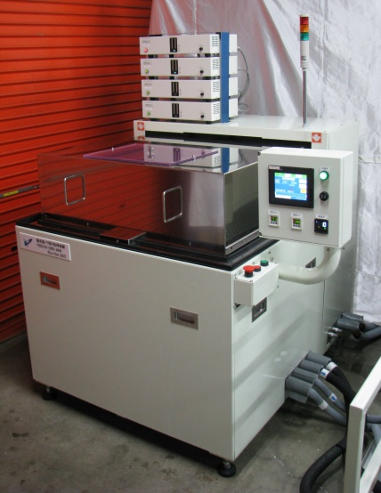
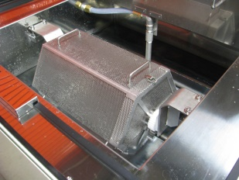
High-speed precision ultrasonic barrel finishing machine replacing conventional barrel finishing machines
Sent on February 14, 2018
Ultrasonic Barrel Finishing Equipment
PERION-DBR series now on sale
Fully automatic deburring and polishing system for bearing retainers After the release of VEGA, inquiries for a small ultrasonic barrel deburring and polishing system increased rapidly and deliveries continued, so we decided to launch the system as a standard machine.
The object is placed in a rotating hexagonal cage and irradiated from outside the cage with powerful ultrasonic waves for deburring, The device removes burrs and polishes the surface by the impact force of the generation and annihilation of cavities (micro vacuum nuclei) of 10 mm in diameter and the co-dragging effect of ultrasonic vibration.
Various precision sheet metal parts, electronic parts, etc., ranging in size from 0.5 mm to 30 mm.
The number of pieces can range from 1,000 to 300,000 in a batch, with deburring, polishing, and powerful cleaning performed at the same time.
Unlike existing barrel machines, this machine does not use media such as stones, but only water and ultrasonic waves to deburr and polish at a faster speed than conventional machines.
Difference between ultrasonic barrel finishing and conventional barrel finishing No media is used. Only water and ultrasonic waves are used.
The work to separate the media from the workpiece is no longer necessary.
Eliminates defects caused by media contamination.
The replacement and management of media will no longer be necessary.
No media, so they are free from heavy labor.
Deburring and polishing speeds averaging several times faster than existing barrels
(Customer Rating.)
** At the same time, precision cleaning is possible, and it can be used for electronic parts with complex shapes that do not tolerate contamination. It can also be used for electronic components with complex shapes that are sensitive to contamination.
Wastewater treatment is not required.
In addition to city water, pure water, water-soluble rust inhibitors, and hydrocarbon solvents can be used.
Drying is easy, and full automation can be easily achieved.
*Reduce labor costs, stabilize quality, and increase production efficiency.
Standard model type (1) PERION-DBR-1200 Ultrasonic wave 1200W Frequency 25KHz～275KHz Simultaneous multiple wave Hexagonal cage shape, diameter 150φ x length 200mm, volume 3ℓ, standard price **10,000
②PERION-DBR-2400 Ultrasonic 2400W Frequency 25KHz-275KHz simultaneous multiple wave
Hexagonal cage shape, diameter 200φ x length 300mm, volume 7.8ℓ, standard price *** million yen
(3) PERION-DBR-3600 Ultrasonic wave 3600W Frequency 25KHz-275KHz simultaneous multiple wave
Hexagonal cage shape, 250φ diameter x 400mm length, 16.2ℓ volume, standard price *** million yen
④PERION-DBR-4800 Ultrasonic 4800W Frequency 25KHz to 275KHz simultaneous multiple wave
Hexagonal cage shape, diameter 300φ x length 500mm, volume 29.2ℓ, standard price *** million yen
Sales target
Total of 36 units of each model Approx. 200 million yen
Our introduction video is now available on Youtube! Learn about Blue Star R&D in 3 minutes! → Video A little more detail in 10 minutes! → Video *Ultrasonic barrel finishing is being demonstrated in our laboratory! (Reservations required) | <Company Profile Representative: Miyuki Shibano Establishment] April 22, 2010 Capital] 10,000,000 yen Business] Ultrasonic Cleaning Ultrasonic Deburring Equipment Manufacture and sale of ultrasonic cavitation application equipment [URL] http://www.blue-galaxy.co.jp/
＜Inquiries regarding this matter Please contact Blue Star R&D Inc. TEL：042-711-7721 FAX：042-711-7237 E-mail：blue_star@blue-galaxy.co.jp

